Slide 1
Applications for Precision Time Synchronization in Data Centers
Ahmad Byagowi

Slide 2
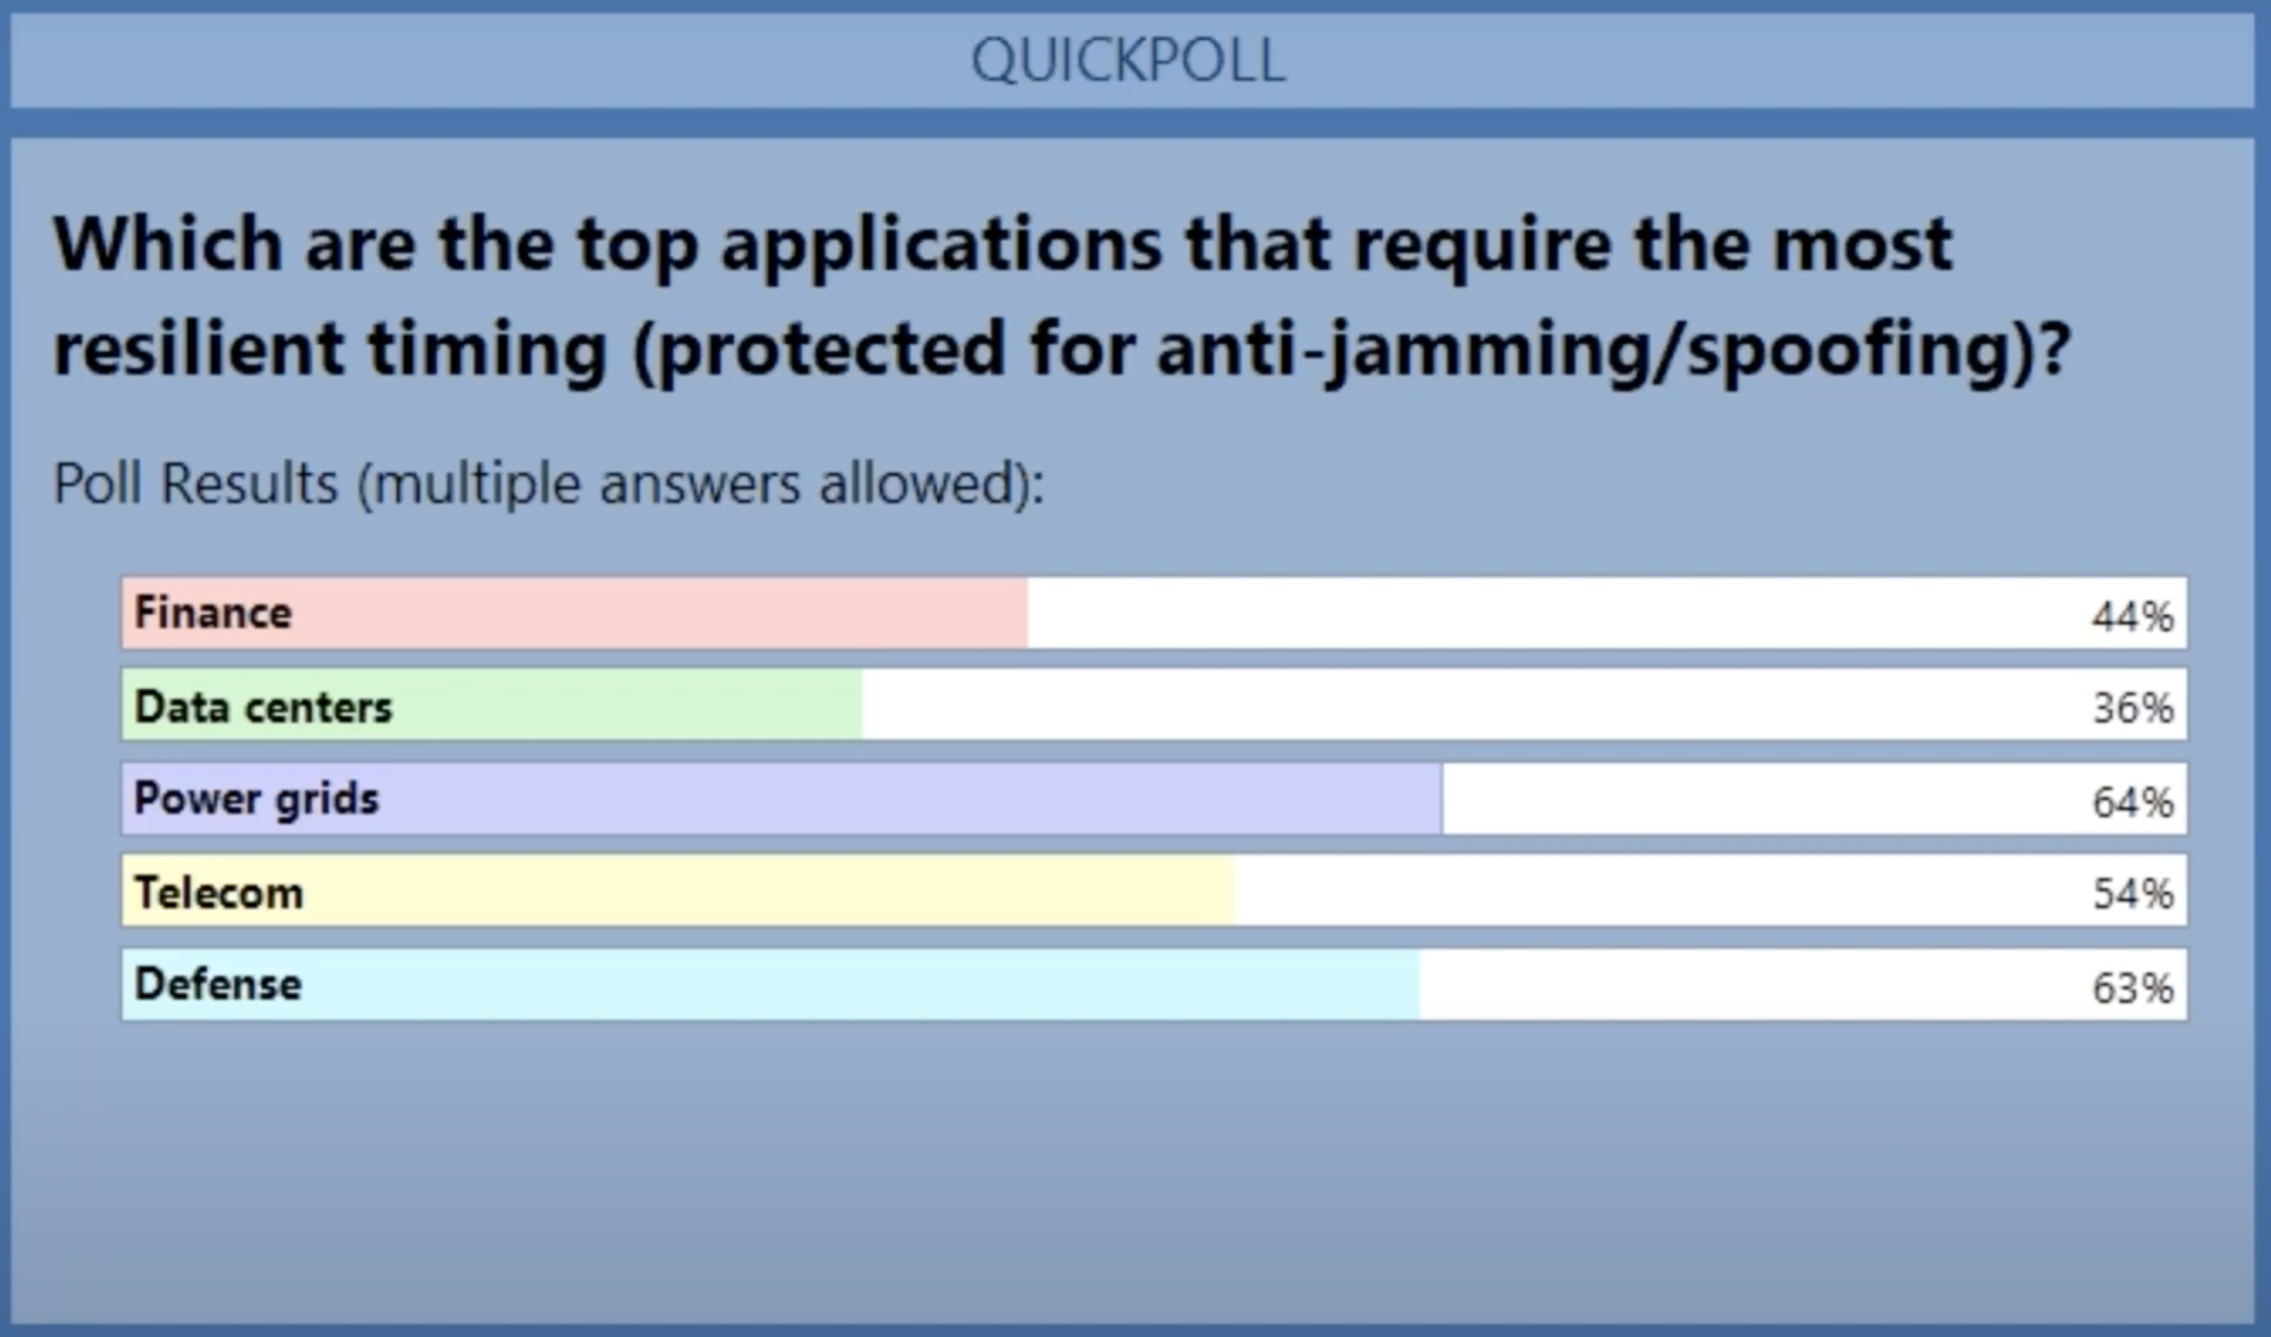
Motivation
Septentrio’s Webinar

Slide 3

The Evolution of Cells
In early development of life, there were cells who evolved to sense light [Sensor]
  They survived from being overexposed and fried by the the Sun.
Later from those cells, some started to develop the ability to predict the rise and set of the Sun. [Synchronization]
  Those who did not have that perished.
With the presence of changes in day length some cells learned to adopt to the changes. [Syntonization]
  Those who did not have that perished.
#74: Brain's clock and Time Dissemination in the Body

Slide 4

How to Provide Sync. and Synt.
Time keeping in computers is based on counting the periods of an oscillator
Oscillators are unique, like everything else in this world.
  Every oscillator got its own frequency and characteristics
Timer is an integrator of periods of an oscillator
$$\int{ω^{−1}\left(t\right)dt}=Duration+c$$
Clock is made by adding a specific offset (c) to the timer
The offset (an arbitrary value) is constantly evolving.
  You need to receive the offset value to align to a given event
Due to the presence of various perturbations, oscillators frequency constantly changes.
  You need to receive a correction for the frequency of the oscillator on hand

Slide 5
Once you HAVE SYNC
Like those cell, you will have the ability to observe your surroundings and be able to predict things.
Synchronized and Syntonized clocks act like entangled counters.
  If you read two or more entangled counters simultaneously, you should get the same value.
Clock 1
Clock 2
“Pseudo Entanglement”

Slide 6
What Can we do with all of this
Synchronization (Phase)
  Active (Class 1)
    Running Events at a specific time
      Sync or desync
  Reactive (Class 2)
    Measure latency, time or intervals
Syntonization (Frequency)
  Active (Class 3)
    Calibrate speed and align runtime to reduce tail latency
  Reactive (Class 4)
    Measure heterogeneity or provide binning
 | Active | Reactive
Phase | Class 1 | Class 2
Frequency | Class 3 | Class 4

Slide 7
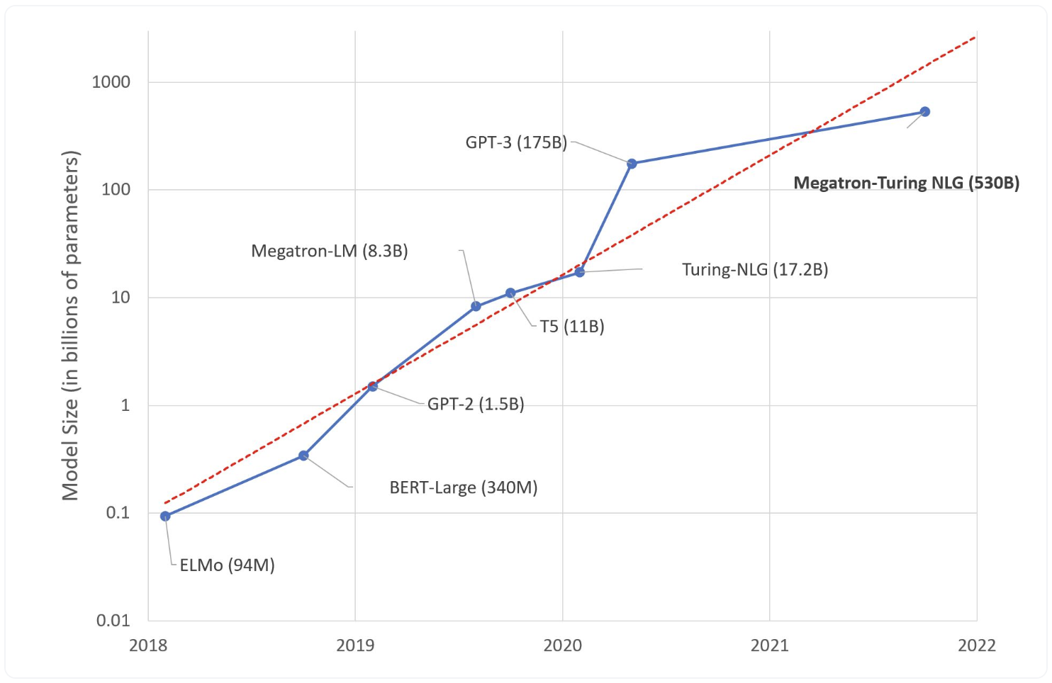
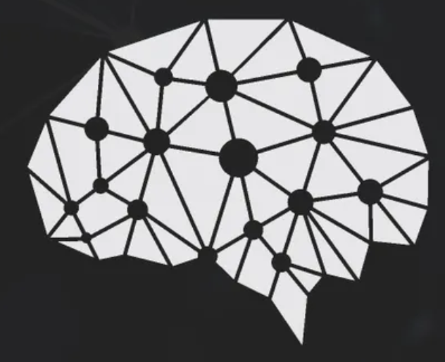
The Evolution of LLMs
Parameters
Human Brain:
Average of 86 billion neurons and 100 trillion synapses
https://huggingface.co/blog/large-language-models

Slide 8
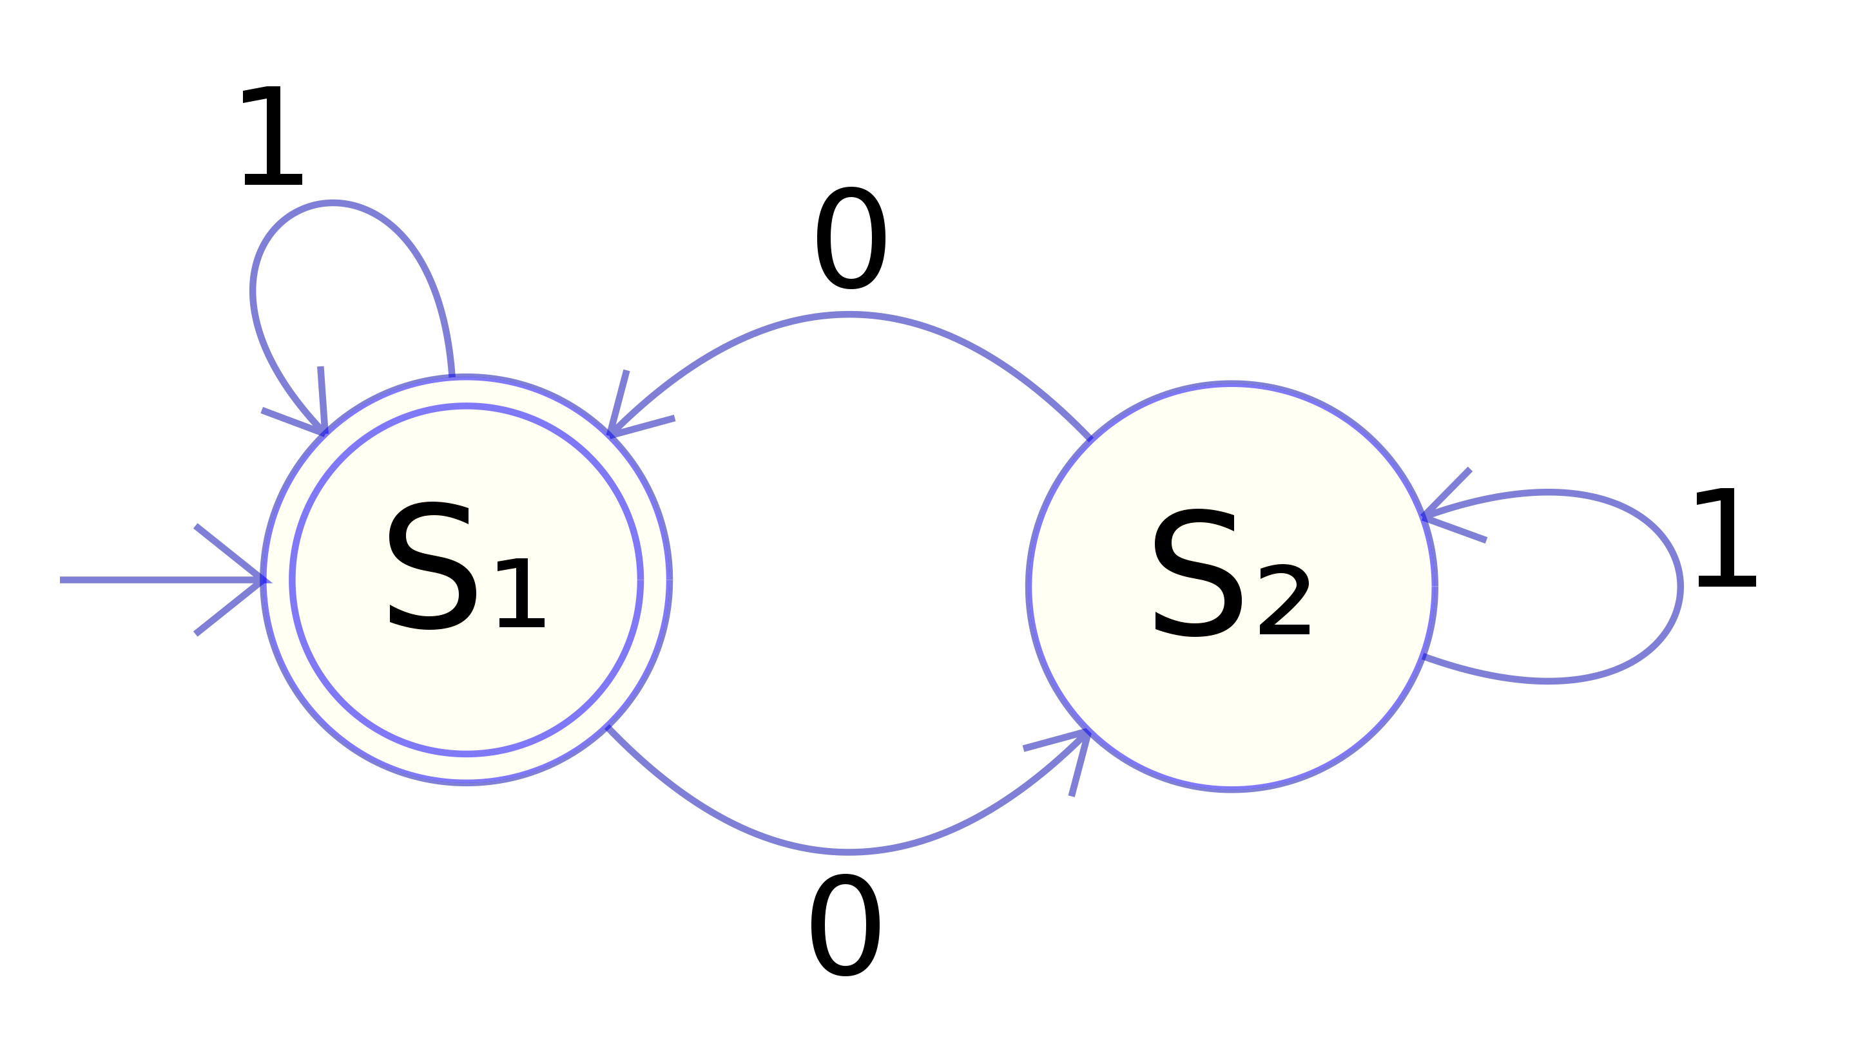
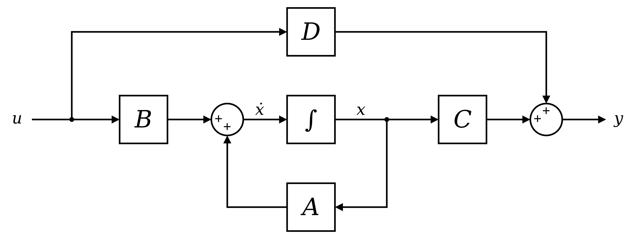

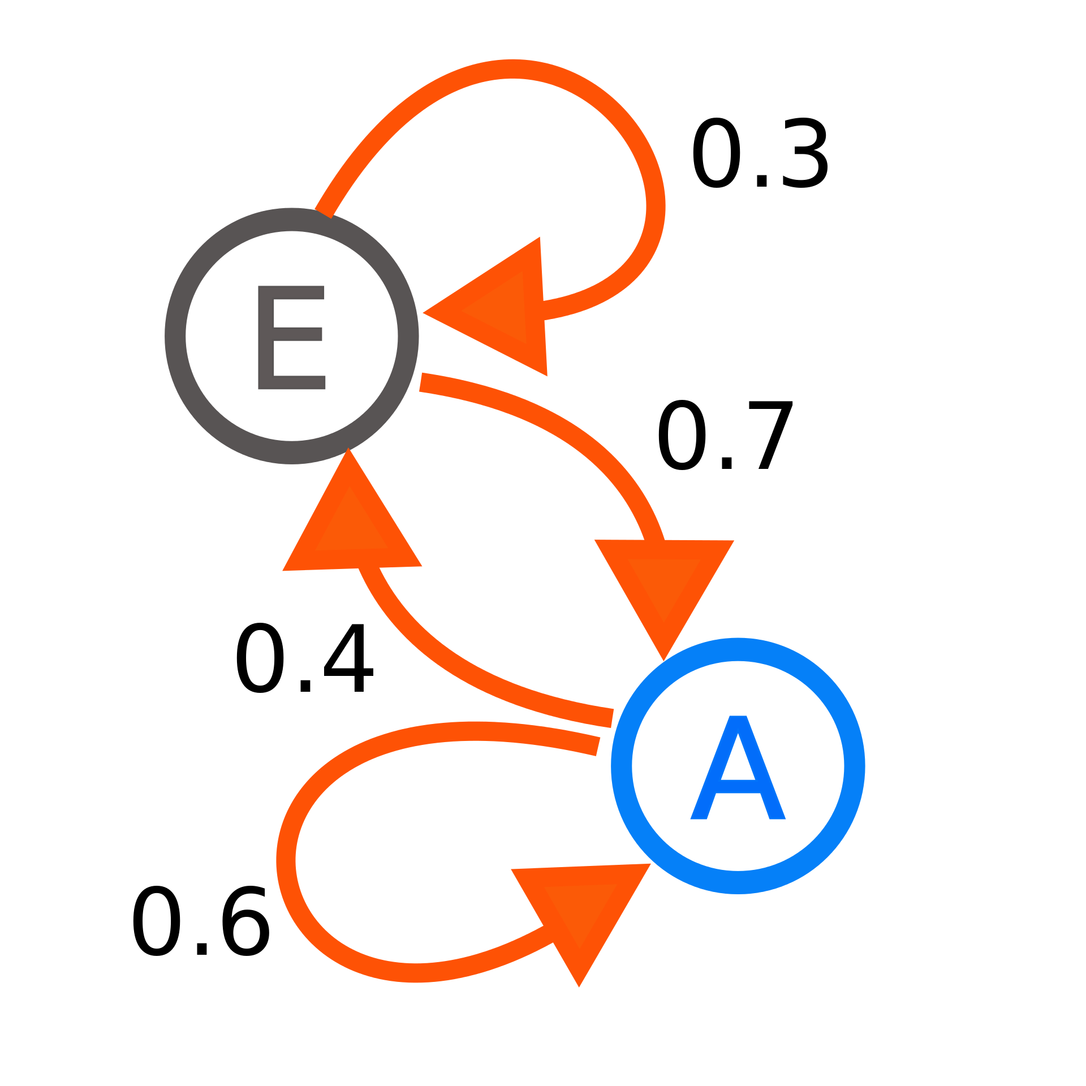
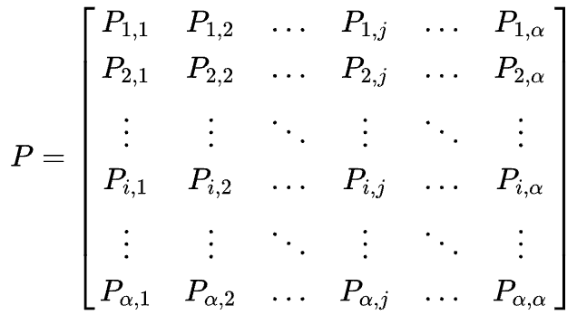
Family of State Machines
Finite State Machines
State Space Representation
S1(n-1)
S2(n-1)
Si(n-1)
Sα(n-1)
S1(n)
S2(n)
Si(n)
Sα(n)
Markov Chains
State Transition Matrix (Stochastic Matrix)

Slide 9
Simplified Application for stochastic Matrix
Multiply
8
 | I | have | an | Apple | Orange | for | you
I | 0 | 1 | 0 | 0 | 0 | 0 | 0
have | 0 | 0 | 1 | 0 | 0 | 0 | 0
an | 0 | 0 | 0 | 0.5 | 0.5 | 0 | 0
Apple | 0 | 0 | 0 | 0 | 0 | 1 | 0
Orange | 0 | 0 | 0 | 0 | 0 | 1 | 0
for | 0 | 0 | 0 | 0 | 0 | 0 | 1
you | 0 | 0 | 0 | 0 | 0 | 0 | 0
4
Add
2
1
Dot Product
0.5
Apple
1
1
1
I have an Apple for you
I have an Orange for you
I
1
have
an
for
you
Orange
0.5
1

Slide 10
Class 1: Running Events at A specific time
Nominal
D(1)
Nominal
Nominal
Nominal
D(0)
Nominal
Nominal
D(-1)
Nominal

Slide 11
Class 3: Heterogeneity and Runtime Alignment
Time Axis
Machine A
Machine A
Machine A
Machine A
Machine B
Machine B
Machine B
Machine B
Pipelines
Machine C
Machine C
Machine C
Machine C
Machine D
Machine D
Machine D
Machine D
Epoch #1
Epoch #2
Epoch #3
Epoch #4

Slide 12
Class 2: Associate Events Between Machines
Event 1234
Event 1235
Event 1236
Event 1237
Event 1238
Event 1239
Event 1240
Event 1403
Event 1404
Event 1405
Event 1406
Event 1407
Event 2044
Event 2045
Event 2046
Event 2047
Event 2048
Event 2049
Event 2050
Event 2051
Machine Local Time
Machine Local Time
Machine Local Time
Event 1653
Event 1654
Event 1655
Event 1656
Event 1657
Event 1282
Event 1283
Event 1284
Event 2077
Event 2078
Machine A
Machine B
Machine C

Slide 13
Class 4: Minimize Network Congestion
Packet Pacing
Approaching Zero Divergence of flow
∇ · flow = 0

Slide 14
Class 1: Consensus in Distributed Databases
Consistency vs Availability
Consistency using:
  Handshaking (Paxos)
  Moving from Logical Clock to Physical Clock
    Commit and wait
  With Precise Clocks
    Commit zero wait (CAL theory)
Consistency
Availability
Partition Tolerance

Slide 15

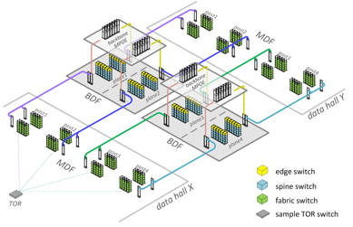
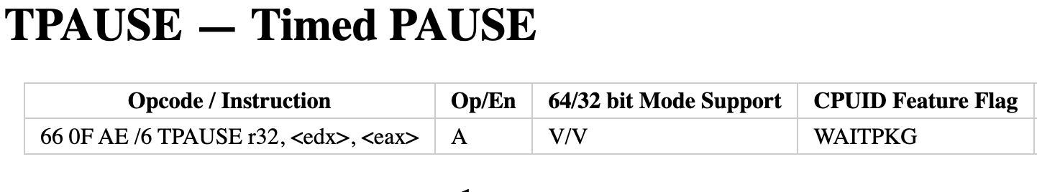
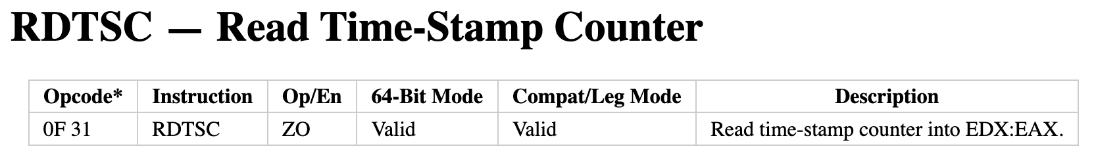







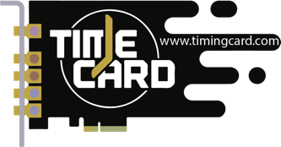

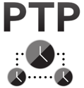
How can we do all of this
GNSS
SPTP
CPU’s
TSC
Data Center
TPAUSE
RDTSC
IEEE P3335
PTM & PFM
IEEE 1588
Global
Local Network
Inside Machines

Slide 16
State of the ART
NTP
PTP w/o PTM
Packet Latency (Globally)
PTP+PTM
Industry Standard Physical Clocks
WR+PTM
Userland
OS
One way Latency (P2P)
Tangle
DC like a PC
MMU
INT
500ms
100ms
20ms
2ms
1ms
500us
250us
100us
50us
20us
5us
1us
500ns
100ns
10ns
1ns
100ps
10ps
1ps
Real Time Linux
Disk
Operations
DDP
CCP
Wall Clock
Network
Operating System
CPU, GPU

Slide 17
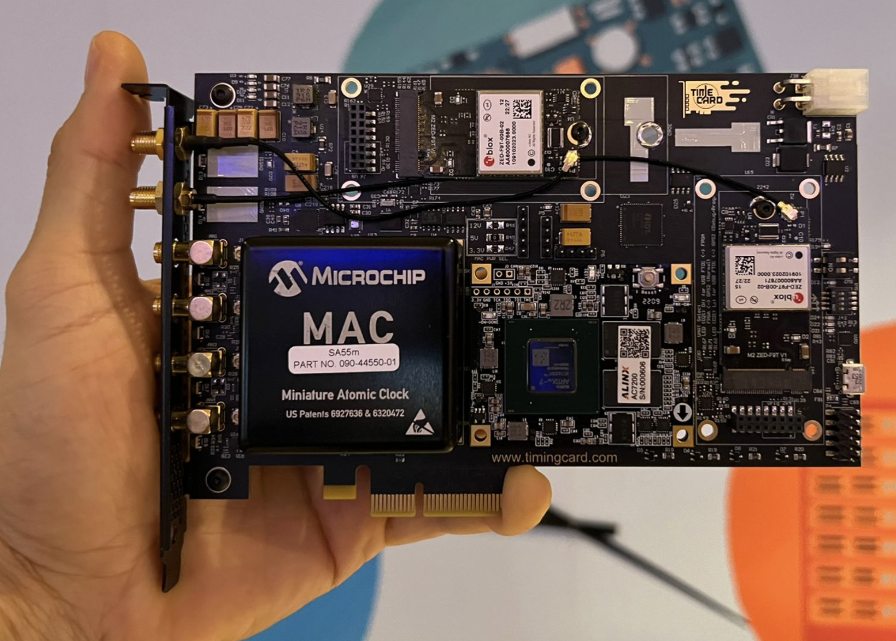
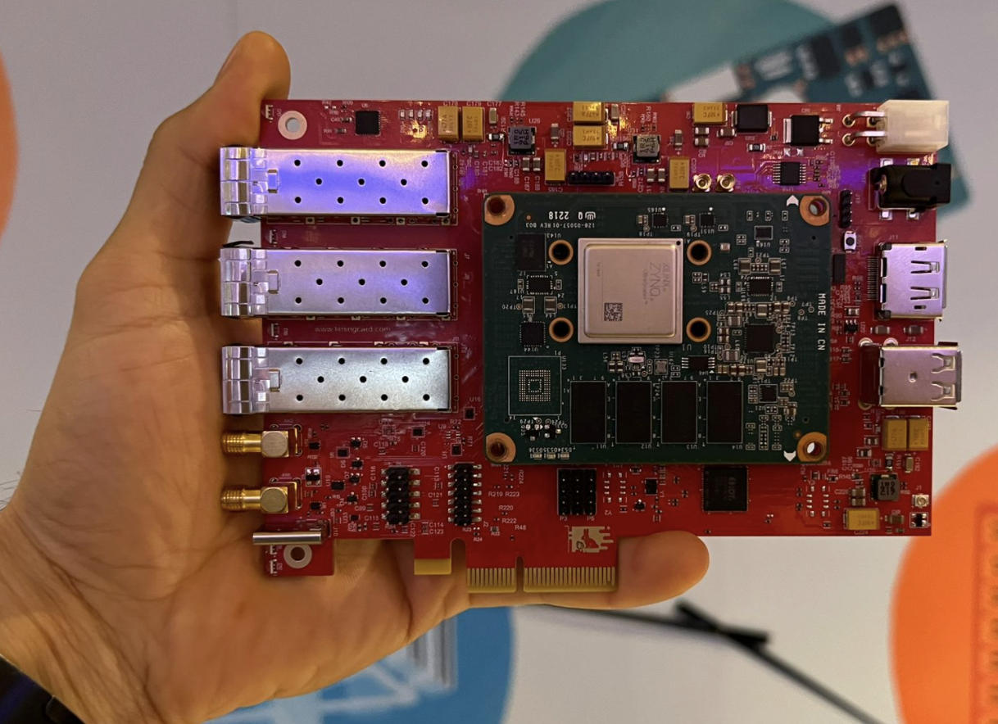
Latest Open-Source Hardware

Slide 18

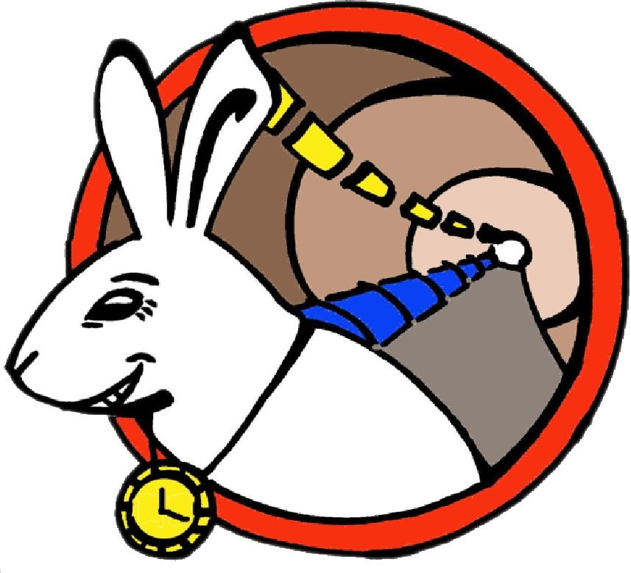




Latest Open-Source Hardware

Slide 19
Conclusion
Datacenter Applications for Timing can be divided in 4 classes:
  Active applications enforce things to execute at a specific time or frequency
  Reactive applications measure time or frequency
As the demand or capacity scales up:
  Heterogeneity increases
  Temporal Optimization becomes a need
  Alignment of events becomes crucial
Different domains require unique solutions

Slide 20
Let’s learn from the Cells!

Slide 21

Thank you

Slide 22

Thank you

